Slide 1
Decision Dashboard for Urban Food Production
Weekly Progress Update — Week 6
Focus: USDA Food-Access Data Validation and Parcel Screening
Chiranjeevi Venkata Shiva Ruthvik Savaram, Y247K345, 10/21/2026
Notes:
Good [morning/afternoon]. This is my Week 6 update. There were two workstreams. First, I prepared and validated the USDA food-access data, including a census-tract geography compatibility problem I had to work through. Second, I acquired the Kansas City, Missouri parcel data and did a preliminary vacant-land screening. Both feed the same goal: reliable health, socioeconomic, food-access, and parcel data for a suitability analysis later. Everything is preliminary.

Slide 2
Tasks
Previous Week
This Week
Built the 516-tract dataset: CDC PLACES health, ACS 2019 socioeconomic — Completed
Preliminary map of the 516 project tracts — Completed (preliminary)
Health and socioeconomic correlation screening — Completed (preliminary)
USDA food-access extraction and tract-vintage investigation — Completed (preliminary)
Vacant-land / parcel data collection — Not Started (now begun)
USDA food access
Inventoried the USDA Atlas 2019 fields (147 fields, 146 definitions found); identified 7 candidate indicators — Completed
Checked tract geography compatibility: 2019 geography matched 516 of 516; 2020 IDs matched 430 — Completed; crosswalk analysis still in progress
Ran input-validation checks on the USDA 2025 workbook (84,119 records) — Completed for the checks performed
Compared food-access indicators and their missingness — Completed (preliminary)
KCMO parcel data
Acquired and quality-checked the KCMO parcel layer (269,834 records) — Completed
Screened vacant-land candidates, tested them against the study area, assigned them to tracts, and merged counts — Completed (preliminary)
Kansas parcel data — Not Started
Decision Dashboard for Urban Food Production — Weekly Progress
2
Notes:
Last week I had the health, socioeconomic, and food-access data and a preliminary map, and the parcel category hadn't started. This week had two parts. On USDA: I inventoried the fields, checked that the tract geography is compatible with my 516 tracts, validated the data, and compared candidate indicators. On parcels: I acquired the KCMO parcel data, screened candidates, and merged counts into the tract file. The crosswalk analysis for the tract-vintage issue is still in progress, and Kansas parcel data hasn't started.

Slide 3
Project Objective and Data Foundation
Goal: understand where urban food production opportunities may exist by combining food-access needs, health and socioeconomic indicators, and potential land availability.
Data preparation and validation
Parcel screening and integration
AHP / MCDA scoring
Dashboard
Current focus
Existing dataset: 516 unique census tracts
CDC PLACES (2023)
ACS 5-year (2019)
USDA Food Access Research Atlas (2019)
Health indicators, e.g., obesity, diabetes, high blood pressure
Socioeconomic and demographic candidate variables
Food-access variables; this week's validation and geography checks are on slides 4–6
New this week: a fourth data source — KCMO parcels — which will be attached to the same 516-tract file as tract-level counts.
Decision Dashboard for Urban Food Production — Weekly Progress
3
Notes:
The overall goal is to understand where urban food production opportunities may exist by combining food-access need, health and socioeconomic indicators, and land availability. I'm still in the data preparation and validation stage, now including parcel screening. After that come AHP and MCDA scoring, then the dashboard. My dataset has 516 tracts with health, ACS, and USDA food-access variables. This week I validated the USDA data and added parcels as a new source.

Slide 4
USDA Food Access Atlas: Inventory and Validation
Two separate pieces of work on two USDA workbooks — understand each variable before choosing one
Field inventory — FoodAccessResearchAtlasData2019.xlsx
Input validation — 2025-sram-fara-data.xlsx
147
146
7
84,119 records
in each sheet of the full workbook (not limited to the 516 study tracts)
fields inventoried
definitions found
candidate indicators
No duplicate tract IDs
in either input
Candidate indicators for evaluation (not final selections)
No missing values
LA1and10
LAhalfand10
LILATracts_1And10
lapop1share
in the checked low-access count or POP2020 fields
LAPOP1_10
LALOWI1_10
lalowi1share
No low-access count above its population
in the checked fields
Why inspect definitions? Similarly named indicators can describe different populations, distance thresholds, or types of food access. Each must be understood before it goes into a suitability model.
All 532 older tracts passed the crosswalk overlap-share check
shares approximately 1 (0.99–1.01)
Why it matters: these checks flag duplicate IDs, missing essential values, implausible counts, and incomplete geographic relationships before data enters the workflow. They cover only the fields and conditions tested, and do not validate every field of the 2019 workbook.
Source: USDA ERS Food Access Research Atlas workbooks; project scripts (inventory and input-validation checks)
Decision Dashboard for Urban Food Production — Weekly Progress
4
Notes:
There are two pieces of USDA work, on two different workbooks. First, the field inventory, from the 2019 Food Access Research Atlas workbook: 147 fields inventoried, definitions found for 146, and seven candidate indicators marked for evaluation: LA1and10, LAhalfand10, LILATracts_1And10, lapop1share, LAPOP1_10, LALOWI1_10, and lalowi1share. These are candidates for evaluation, not seven final choices. I inspect definitions because similarly named indicators can describe different populations, distance thresholds, or types of access. Second, the input validation, which I ran on the 2025 workbook, 2025-sram-fara-data.xlsx, using the 2020 tract IDs: 84,119 records in the driving-distance sheet and 84,119 in the population sheet (the full workbook, not records for my 516 tracts), no duplicate tract IDs in either, no missing values in the low-access count or POP2020 fields, no low-access count exceeding its population, and all 532 older tracts in the crosswalk passed the overlap-share check. These checks cover only what the script tests. They don't validate every field, and they aren't about the 2019 workbook.

Slide 5
Census Tract Geography: A Compatibility Problem
Tract IDs and boundaries change between census vintages, so a direct ID match does not guarantee geographic equivalence.
516 / 516
430 / 516
Verified
The working geography of 516 tracts matched all 516 of the 2019 boundary IDs.
A direct 2020 ID comparison matched only 430 of 516.
2019 boundary IDs matched all project tracts
2020 boundary IDs matched; 86 unmatched
Recorded diagnostics | Result
Crosswalk relationship rows | 958
Distinct older tracts in crosswalk | 532 (all passed overlap-share check)
Still requires work
The 2019 boundary match validates the project geography; aligning USDA indicators across tract vintages is a separate step that still needs crosswalk evaluation. No universal one-to-one mapping is claimed.
Population allocation still needs a suitable method; land-area shares alone are not a reliable proxy for where people live.
The crosswalk is a relationship table: one older tract can relate to several newer tracts, so 532 need not equal 516.
Source: Census tract boundary and relationship files; USDA ERS Food Access Research Atlas; project geometry checks
Decision Dashboard for Urban Food Production — Weekly Progress
5
Notes:
This was the main problem. Census tract IDs and boundaries change between vintages, so a direct ID match doesn't guarantee geographic equivalence. My working geography has 516 tracts and matched all 516 of the 2019 boundary IDs. A direct comparison with 2020 boundary IDs matched only 430, leaving 86 unmatched. I also checked the crosswalk: 958 relationship rows covering 532 distinct older tracts, and all 532 passed the overlap-share check. The crosswalk is a relationship table — one older tract can relate to several newer tracts — so the number of older tracts need not equal my 516. Matching my 516 tracts to the 2019 boundary IDs validates my project geography; aligning the USDA indicators across tract vintages is a separate step that still requires crosswalk evaluation. I'm not claiming a one-to-one mapping, and population allocation still needs a suitable method; I won't use land-area shares alone because land area isn't where people live.

Slide 6
Food-Access Indicator Evaluation and Missingness
Compared across the 516 project tracts before choosing an indicator
Tracts with a value (of 516)
LA1and10 mean = 0.432
LA1and10
It is a binary low-access flag, so 43.2% of the 516 tracts carry the flag (about 223 tracts). It does not mean 43.2% of the population has low food access.
516 available · 0 missing
lapop1share
415 available · 101 missing
LAPOP1_10
Current position
354 available · 162 missing
LA1and10 is an initial candidate because it covers all 516 tracts. It is not established as the best measure; definitions and completeness of the alternatives are still being compared.
Missing means unknown or unavailable — not “no food-access problem.” Missing values are not converted to zero.
Source: USDA ERS Food Access Research Atlas (2019); project calculations
Decision Dashboard for Urban Food Production — Weekly Progress
6
Notes:
Here I compared candidate food-access indicators on completeness across my 516 tracts. LA1and10 is available for all 516. lapop1share has 415 available and 101 missing. LAPOP1_10 has 354 available and 162 missing. LA1and10 has a mean of 0.432. That's a binary flag, so it means 43.2 percent of the tracts have the flag — about 223 tracts — not that 43.2 percent of the population has low food access. Missing values mean unknown or unavailable, so I don't convert them to zero. LA1and10 is my initial candidate because it's complete, but I'm not claiming it's the best measure; I'm still comparing definitions and completeness.

Slide 7
Parcel Data Acquisition and Quality
Kansas City, Missouri Cadastre geodatabase (about 200 MB ZIP) — Parcels layer inspected with Python, GeoPandas, and Pyogrio
269,834
42
MultiPolygon
parcel records
columns incl. geometry
parcel geometry type
Data quality finding | Records | Share of 269,834 | Why it matters
Missing land-use code | 69,150 | 25.6% | Parcels cannot be classified; some vacant parcels may be hidden
Missing KIVAPIN | 3,873 | 1.4% | No parcel ID to link or de-duplicate
Duplicate KIVAPIN rows | 3,909 | 1.4% | Risk of double-counting (blank IDs may count as repeats; 265,924 unique IDs)
Invalid geometries | 78 | <0.1% | Can break area and intersection calculations
Missing geometry | 1 | <0.1% | Cannot be placed on a map
Records are flagged, not automatically deleted — each issue needs investigation first, since removing rows could drop real parcels or bias the counts.
Source: KCMO Cadastre geodatabase (Parcels layer); project calculations
Decision Dashboard for Urban Food Production — Weekly Progress
7
Notes:
I downloaded the KCMO Cadastre geodatabase, about 200 MB, and inspected the Parcels layer. It has 269,834 records and 42 columns, as MultiPolygon geometries. Quality checks: about a quarter of the records, 69,150, have no land-use code. 3,873 have no parcel ID, and 3,909 rows are flagged as duplicate IDs. 78 geometries are invalid and one is missing. These matter because missing codes can hide vacant parcels, duplicate IDs can double-count, and invalid geometries can break spatial operations. I haven't deleted anything automatically — I flag and investigate first. One detail: the duplicate count likely includes blank IDs counted as repeats, so it isn't 3,909 genuinely repeated parcels; I want to separate those next.

Slide 8
Preliminary Vacant-Land Candidates
Screening by official KCMO land-use codes — a first filter, not proof of availability or suitability
Codes identified in KCMO GIS documentation
Candidate records by code (22,178 total)
Code | Classification | Use here
9500 | Vacant Residential | Selected
9600 | Vacant Non-Residential (incl. billboards) | Selected
9400 | Permanent Open Space (e.g., flood) | Not selected
8100 | Agricultural | Not selected
8200 | Horticultural | Not selected
1111 | Single Family (Non-Mobile Home Park) | Not selected
9500 Vacant Residential
18,999
9600 Vacant Non-Residential
3,179
Parcel area (sq ft) | Mean | Median
Vacant Residential | 29,642 | 5,984
Vacant Non-Residential | 107,403 | 12,277
Zero assessed improvement value was not used as the only vacancy test.
Means sit far above medians in both groups (about 5× and 9×), so a few very large parcels pull the mean up. Larger does not mean more suitable.
22,177 of the 22,178 candidate records have valid geometry (1 invalid).
Source: KCMO GIS land-use code documentation; KCMO Cadastre geodatabase; project calculations
Decision Dashboard for Urban Food Production — Weekly Progress
8
Notes:
From the city's GIS documentation I identified several land-use codes. For this first screen I picked 9500, Vacant Residential, and 9600, Vacant Non-Residential, as candidate vacant land. That gives 18,999 and 3,179 records, 22,178 in total; 22,177 have valid geometry. This is only an initial screening criterion. It does not prove a parcel is available or suitable for urban food production, and I did not use zero improvement value as the only vacancy test. On size: residential parcels have a mean of about 29,600 square feet and a median of about 6,000. Non-residential has a mean of about 107,400 and a median of about 12,300. In both groups the mean is far above the median, so a few very large parcels pull the mean up. I'm not saying larger parcels are more suitable.

Slide 9
Spatial Integration and Results
From the raw parcel geodatabase to tract-level counts in the project dataset
Raw parcel geodatabase
Land-use filter
Study-area intersection
Parcel-to-tract assignment
Tract-level merge
269,834 records
Codes 9500 + 9600: 22,178 records
22,141 inside; 37 outside
22,139 assigned; 2 unassigned
516 tracts preserved
Both layers were projected to a common coordinate system first. Each parcel goes to one tract via a representative point (not split). The source is Kansas City, Missouri only, so being inside the study area does not mean metro-wide parcel coverage.
Result: tracts with recorded candidate parcels
171 tracts with candidates
345 tracts with zero recorded candidates
516 unique tract IDs preserved · 22,139 assigned candidate parcels · output: kc_metro_health_socioeconomic_parcel_counts.csv
Zero recorded candidates does not mean no vacant land: it means none under the two selected codes in the KCMO source.
Source: KCMO Cadastre geodatabase; existing study-area tract boundaries; project calculations
Decision Dashboard for Urban Food Production — Weekly Progress
9
Notes:
This is the pipeline. I started with 269,834 parcels, filtered to the two vacant codes for 22,178 records, and tested them against my study-area tract boundaries: 22,141 intersect and 37 are outside. I transformed both layers to a common projected coordinate system before that spatial test. Then I assigned each parcel to a tract using a representative point inside the parcel: 22,139 were assigned and 2 were not. Each parcel goes to one tract and isn't split — that's a methodological choice and a limitation. Finally I merged tract-level counts into my dataset: all 516 tracts are preserved, 171 have at least one candidate parcel, and 345 have zero recorded candidates. Zero means none under these two codes in this source, not that there's no vacant land.

Slide 10
Limitations — Results Are Preliminary
USDA food-access data
KCMO parcel data
The 2019 Atlas rests on older source geography and reference data, including a 2019 supermarket list and 2010 Census information.
Crosswalk: 958 relationship rows covering 532 older tracts, all passing the overlap-share check; population allocation still needs a suitable method. No one-to-one mapping is claimed.
Alternative indicators are incomplete (101 and 162 tracts missing); missing values are not zeros.
LA1and10 is a binary tract-level flag, not a population share.
Validation covered specific checks on the 2025 workbook; not every field is confirmed complete.
Source covers Kansas City, Missouri only — not the whole 14-county metro area. Kansas data is still needed.
Zero recorded candidates (345 tracts) means none under codes 9500 and 9600 in this source, not no vacant land.
Land-use codes are an initial screen; availability, ownership, zoning, and suitability are unchecked.
Each parcel is assigned to one tract by a representative point; 2 unassigned, 6 rows with repeated parcel IDs.
69,150 parcels have no land-use code; parcel size is skewed by a few large parcels.
Decision Dashboard for Urban Food Production — Weekly Progress
10
Notes:
Limitations for both workstreams. USDA: the 2019 Atlas is based on older source geography and reference data, including a 2019 supermarket list and 2010 Census information. The crosswalk has 958 relationship rows covering 532 older tracts, all passing the overlap-share check, but population allocation still needs a suitable method and I'm not claiming one-to-one mapping. The alternative indicators have missing tracts, and missing isn't zero. LA1and10 is a binary flag, not a population share. Parcels: the source is Kansas City, Missouri only. Zero recorded candidates doesn't mean no vacant land. The land-use codes are only an initial screen. Parcels are assigned to one tract by a representative point; two weren't assigned and six rows have repeated IDs. And parcel size is skewed.

Slide 11
Next Week Plans (10/28/2026)
Activities/Tasks
Continue the crosswalk investigation and document which geographic matches are verified and which are not
Confirm the seven USDA candidate indicators and compare their definitions and completeness before choosing one
Investigate repeated parcel IDs and the 2 unassigned parcel records
Obtain and inspect Kansas parcel data (Kansas ORKA); document the coverage of both parcel sources
Carried forward: transit-source validation, variable shortlist, and data inventory
Expected Outcomes
A documented geography approach separating verified matches from crosswalk-based work
A better-supported food-access indicator choice
Kansas parcel data inspected, with coverage and quality documented
Deliverable
Geography and indicator documentation, parcel coverage notes, updated dataset (if Kansas data is available), and progress presentation
Decision Dashboard for Urban Food Production — Weekly Progress
11
Notes:
Next week: continue the crosswalk investigation and document verified versus unverified matches, confirm the seven USDA candidates and compare them before choosing an indicator, investigate the repeated parcel IDs and unassigned records, and get Kansas parcel data from ORKA. I'll also continue the Week 5 carry-over items: transit validation, the variable shortlist, and the data inventory. Scoring and the dashboard come after the data is validated.

Slide 12
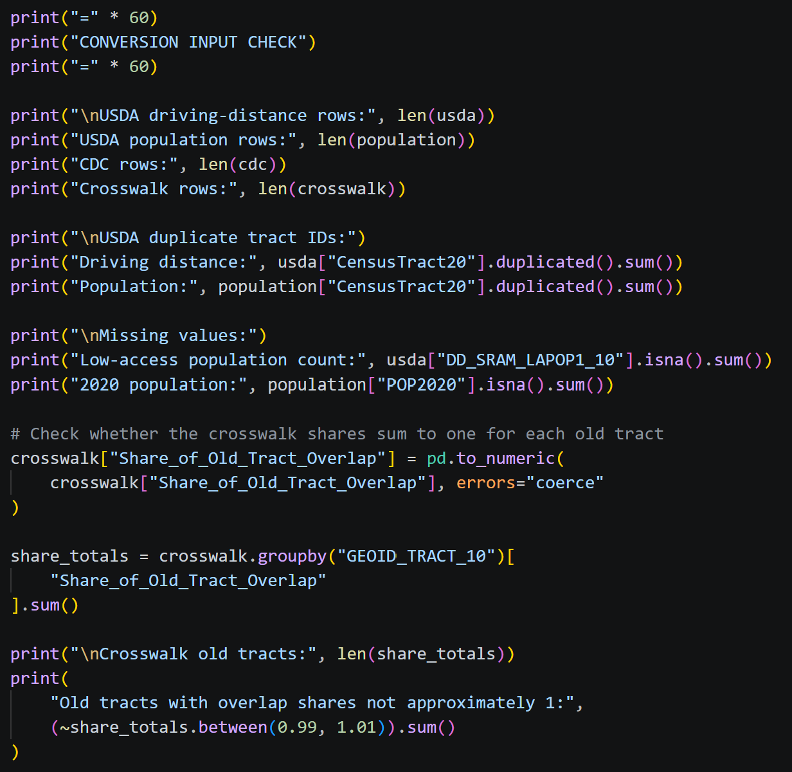
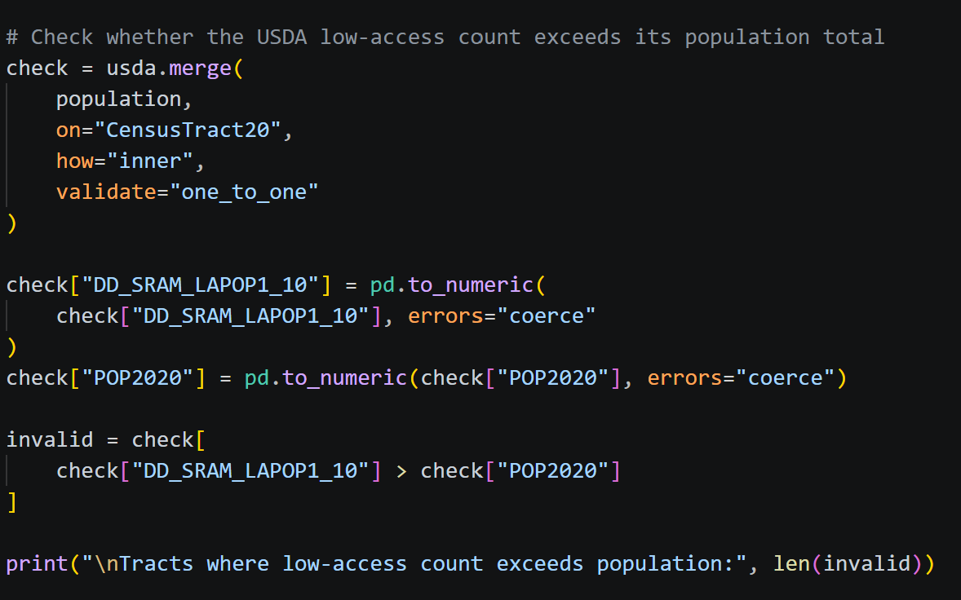
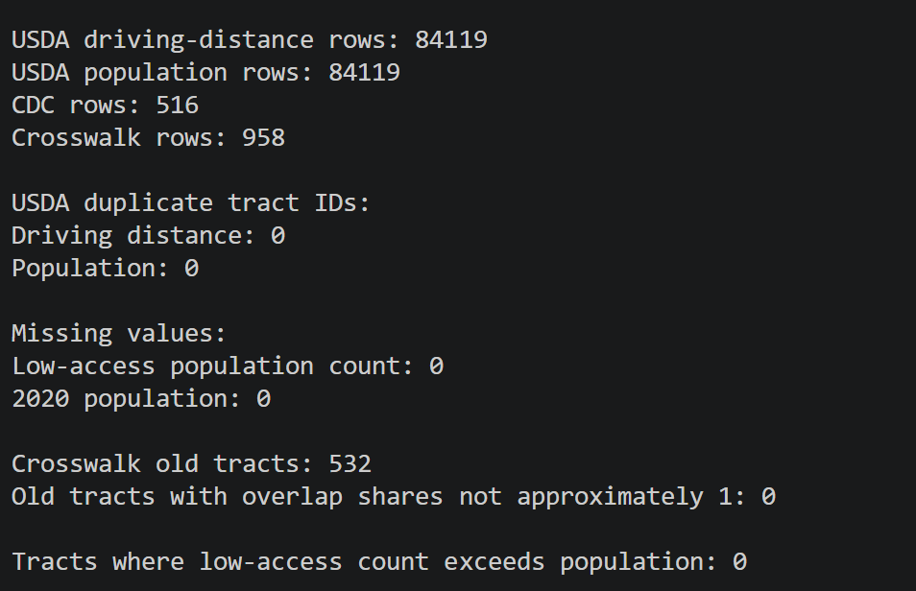
Appendix — Python Implementation: USDA Data Validation.

Slide 13
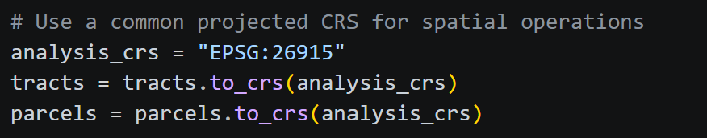
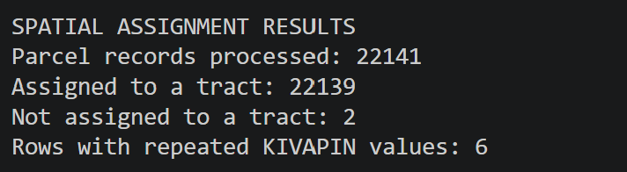
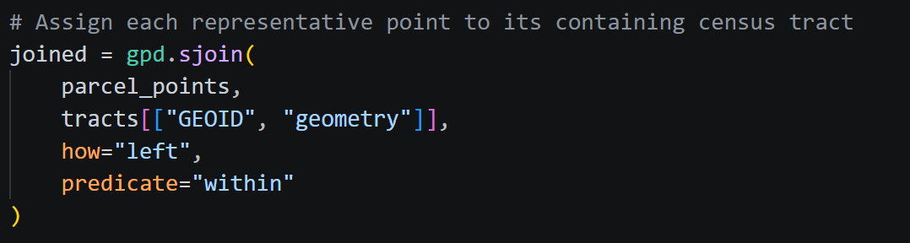
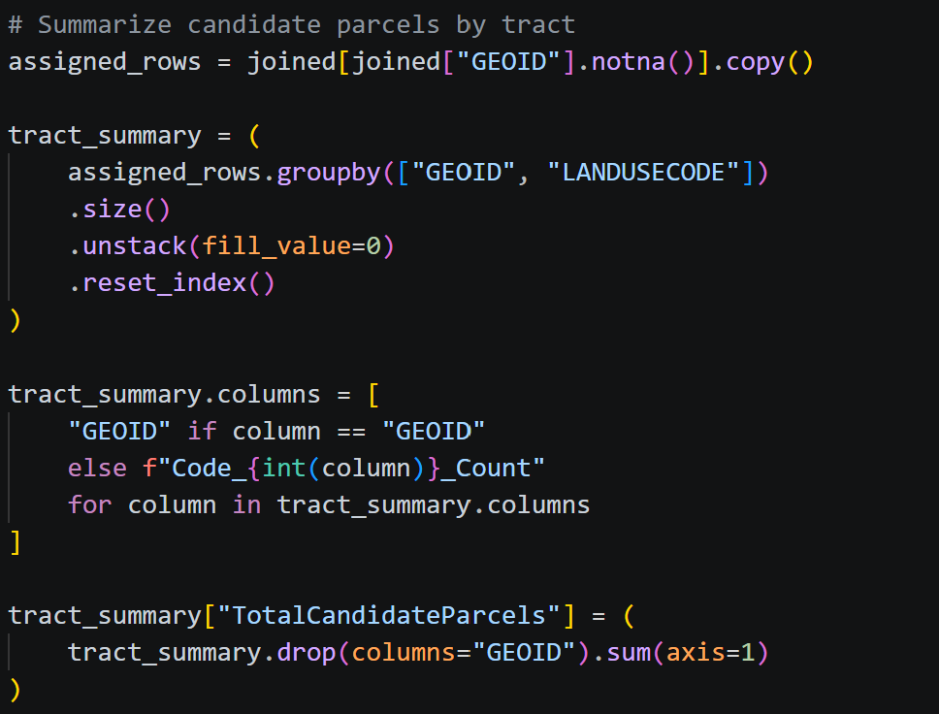
Appendix — Python Implementation: Parcel-to-Tract Assignment
Repeated-ID rows flagged for investigation; not all are confirmed duplicate parcels.

